Slide 1
CS112: Introduction to Python programming
Week 13: Data Visualization I - Matplotlib

Slide 2
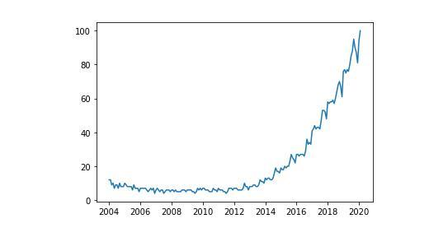
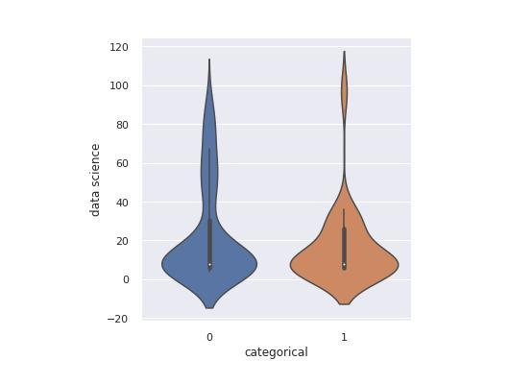
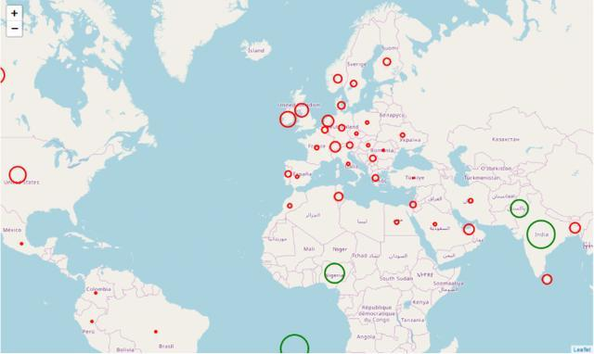
Data Visualization
The graphical representation of data – data visualization – is one of the most important tools for evaluating and understanding scientific data

Slide 3

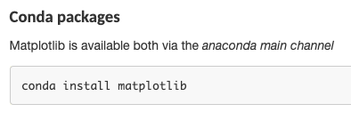
Matplotlib
https://matplotlib.org/
Installation
Matplotlib is one of the most popular Python packages used for data visualization.

Slide 4
Matplotlib
matplotlib makes extensive use of NumPy, so the two usually are imported together:
import numpy as np
import matplotlib.pyplot as plt
There are other matplotlib sub-libraries, but the pyplot library provides nearly everything that you need for 2D plotting

Slide 5
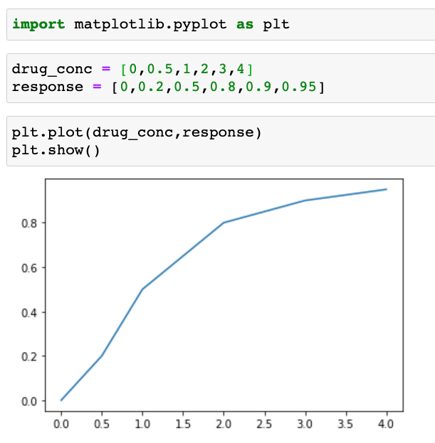
A simple plot
matplotlib.pyplot is a collection of functions that make matplotlib work like MATLAB. Each pyplot function makes some change to a figure: e.g., creates a figure, creates a plotting area in a figure, plots some lines in a plotting area, decorates the plot with labels, etc.

Slide 6
Imperative vs. Object-oriented (OO)
Matplotlib supports both object-oriented and imperative syntax for plotting.
The imperative syntax（命令式编程）(sometimes called 'state-machine' syntax) issues a string of commands all of which act on the most recent figure or axis
The object-oriented syntax, on the other hand, explicitly acts on the objects (figure, axis, etc.) of interest. Recommended

Slide 7
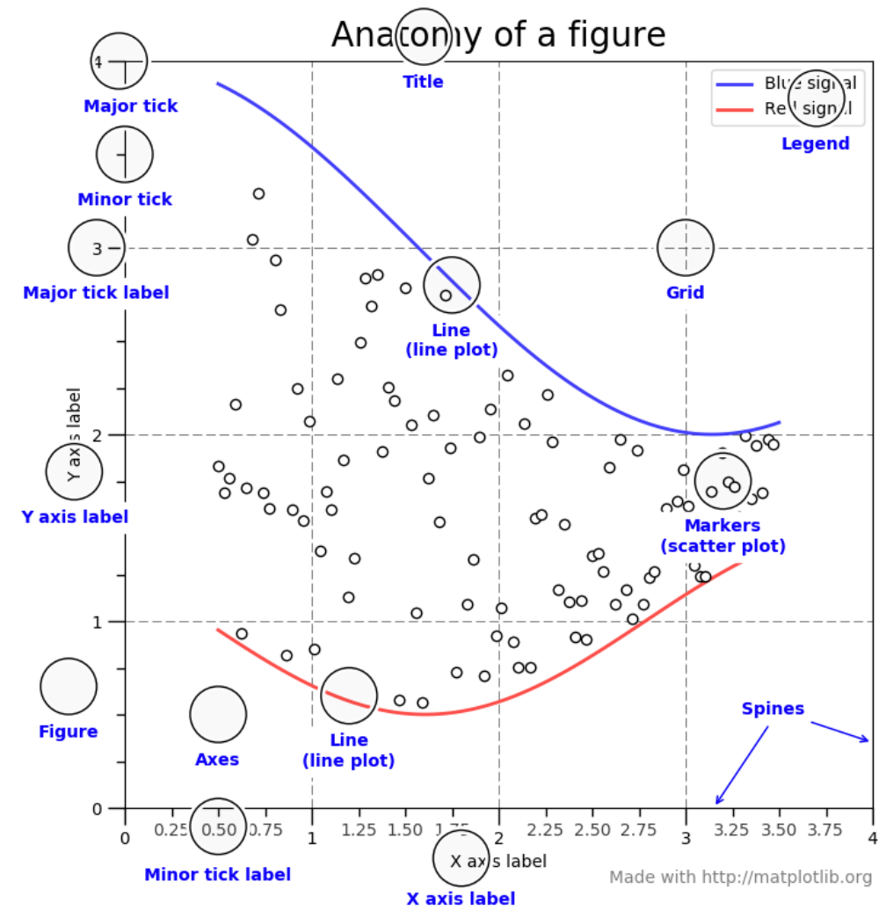
Parts of a Figure
class Figure
The whole figure. The figure keeps track of all the child class Axes
class Axes
This is what you think of as 'a plot', it is the region of the image with the data space.

Slide 8
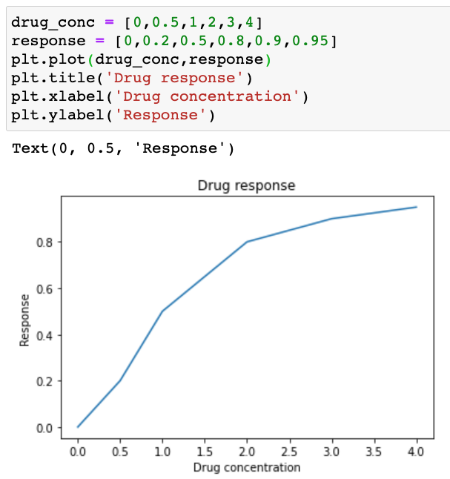
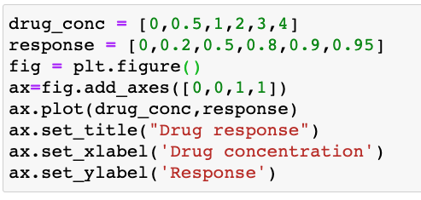
Imperative vs. Object-oriented (OO)

Slide 9
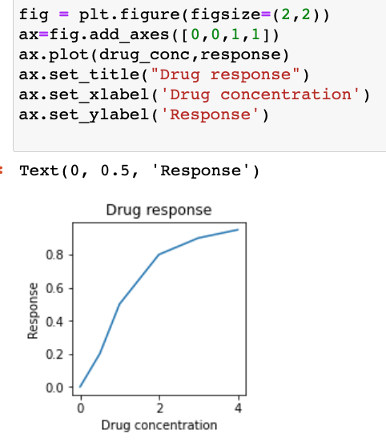
Creating Figure objects
plt.figure( figsize=None,…)
Create a new figure
figsize : (float, float); Width, height in inches.

Slide 10
Adding axes to Figure
add_axes (rect)
Add an axes to the figure.
rect:
The dimensions [left, bottom, width, height] of the new axes. All quantities are in fractions of figure width and height.
Figure
1
0
1

Slide 11
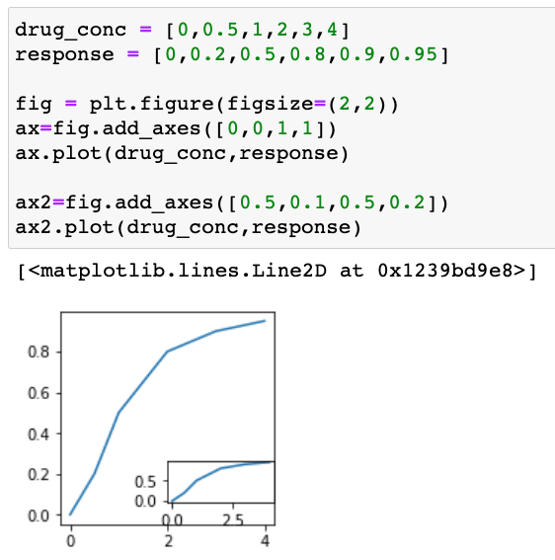
Adding axes to Figure
add_axes (rect)
Add an axes to the figure. c
rect:
The dimensions [left, bottom, width, height] of the new axes. All quantities are in fractions of figure width and height.
Figure
1
0
1

Slide 12
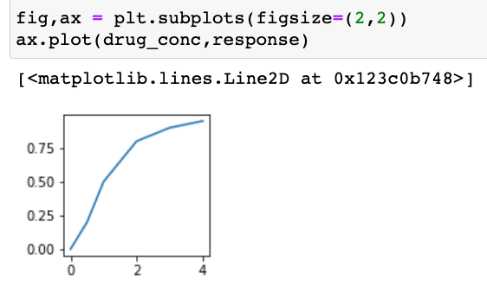
Adding axes to Figure
plt.subplots( nrows=1, ncols=1)
Create a figure and a set of subplots axes;
Return a Figure and Axes

Slide 13
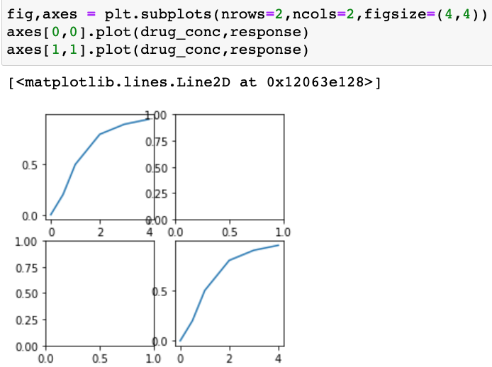
Adding axes to Figure
plt.subplots( nrows=1, ncols=1)
Create a figure and a set of subplots axes;
Return a Figure and Axes

Slide 14
Axes: Types of Plots
Function | Description
Bar | Make a bar plot.
Barh | Make a horizontal bar plot.
Boxplot | Make a box and whisker plot.
Hist | Plot a histogram.
hist2d | Make a 2D histogram plot.
Pie | Plot a pie chart.
Plot | Plot lines and/or markers to the Axes.
Polar | Make a polar plot.
Scatter | Make a scatter plot of x vs y.
Stackplot | Draws a stacked area plot.
Stem | Create a stem plot.
Step | Make a step plot.
Quiver | Plot a 2-D field of arrows.

Slide 15
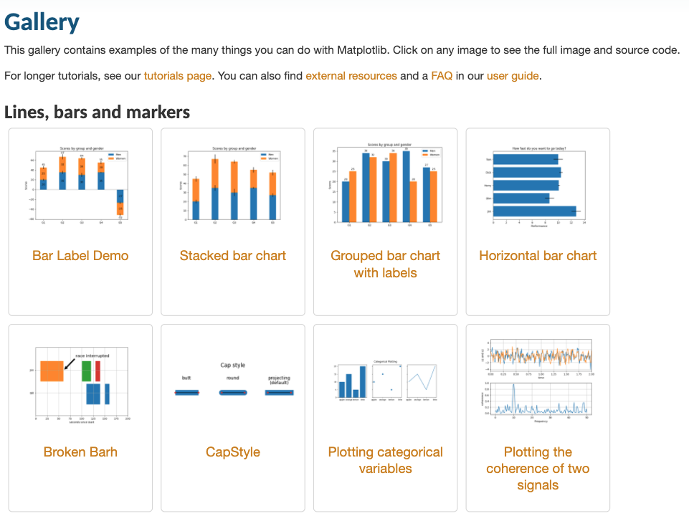
Axes: Types of Plots
https://matplotlib.org/stable/gallery/index.html

Slide 16
Axes.plot()
Plot y versus x as lines and/or markers.
plot (x, y, fmt)
x, y : array-like. The horizontal / vertical coordinates of the data points.
fmt : str, optional; A format string, e.g. 'ro' for red circles.
color, marker, linestyle, linewidth, markersize
Color code
marker
linestyle
Character | Color
‘b’ | Blue
‘g’ | Green
‘r’ | Red
‘c’ | Cyan
‘m’ | Magenta
‘y’ | Yellow
‘k’ | Black
‘w’ | White
Character | Description
‘.’ | Point marker
‘o’ | Circle marker
‘x’ | X marker
‘D’ | Diamond marker
‘H’ | Hexagon marker
‘s’ | Square marker
‘+’ | Plus marker
Character | Description
- | Solid line
-- | Dashed line
-. | Dash-dot line
: | Dotted line

Slide 17
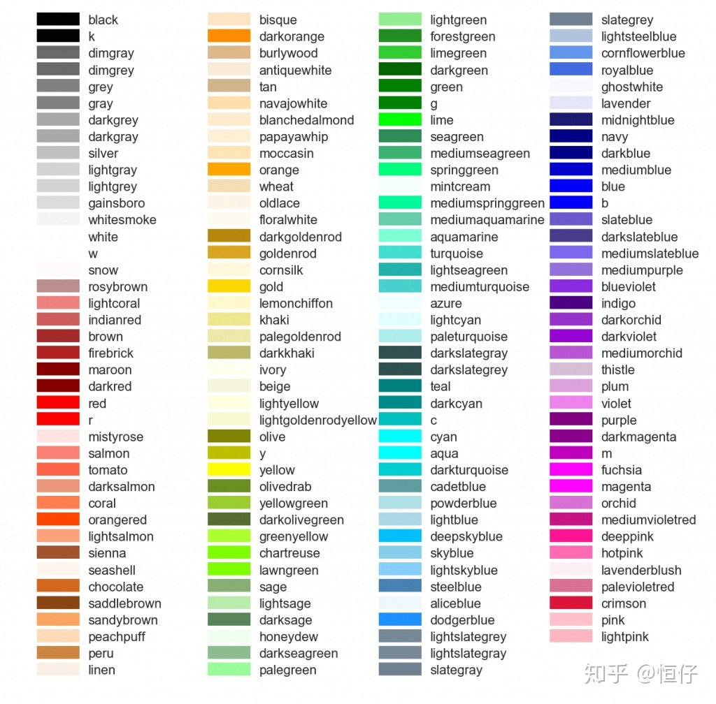
Axes.plot()
matplotlib colors
linestyle
Character | Description
- | Solid line
-- | Dashed line
-. | Dash-dot line
: | Dotted line

Slide 18
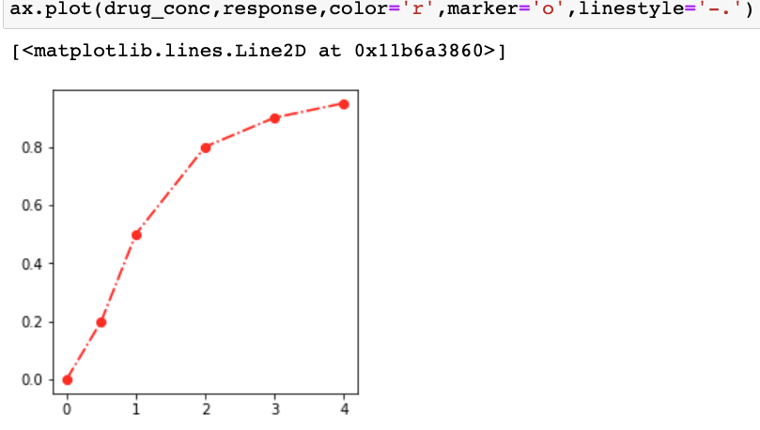
Axes.plot()
Plot y versus x as lines and/or markers.
fmt : str, optional; A format string, e.g. 'ro' for red circles.
color, marker, linestyle, linewidth, markersize

Slide 19
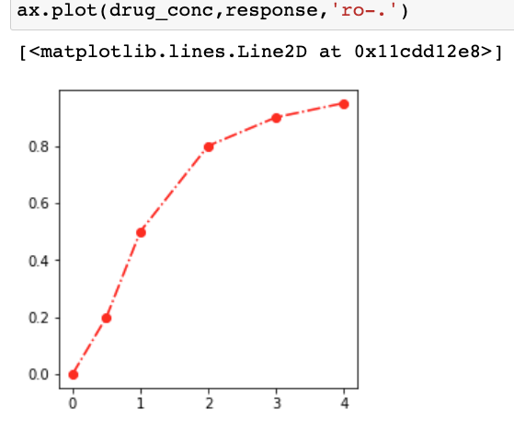
Axes.plot()
Plot y versus x as lines and/or markers.
fmt : str, optional; A format string, e.g. 'ro' for red circles.
color, marker, linestyle, linewidth, markersize

Slide 20
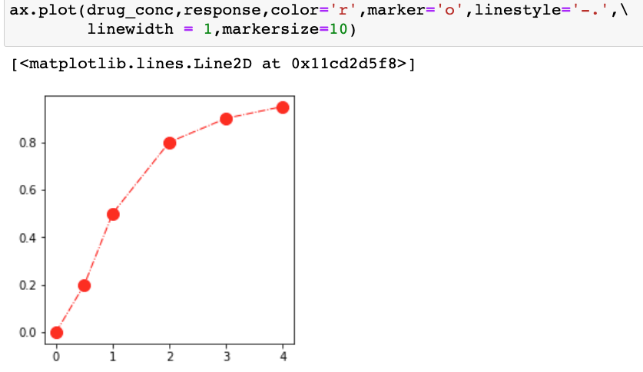
Axes.plot()
Plot y versus x as lines and/or markers.
fmt : str, optional; A format string, e.g. 'ro' for red circles.
color, marker, linestyle, linewidth, markersize

Slide 21
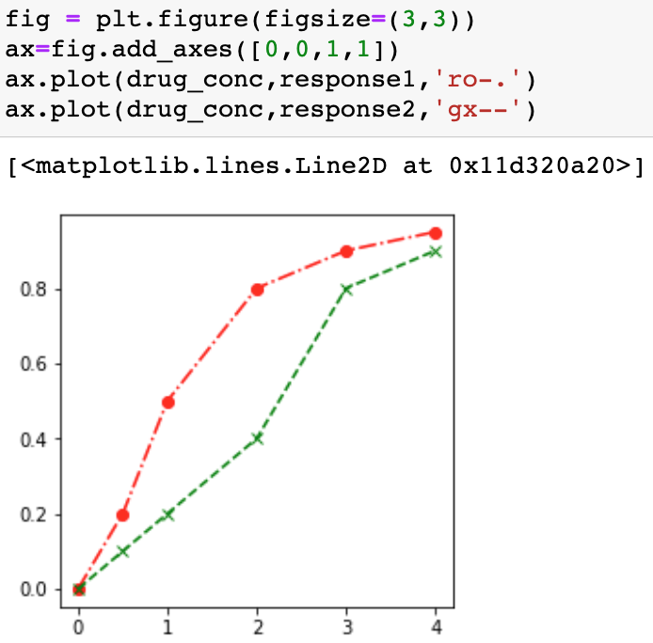
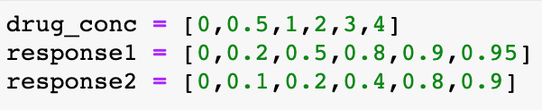
Axes.plot()
Plot y versus x as lines and/or markers.
Multiple lines on the same axes

Slide 22
Parts of a Figure
class Figure
The whole figure. The figure keeps track of all the child class Axes
class Axes
This is what you think of as 'a plot', it is the region of the image with the data space.

Slide 23
Formatting Axes
ax.set_title (label, fontdict=None, loc=None, pad=None, y=None)
Set a title for the axes.
label : str; Text to use for the title
fontdict : dict; A dictionary controlling the appearance of the title text, including 'fontsize’ 'fontweight’, 'color’, etc.
loc : {'center', 'left', 'right’}.
y : float, Vertical axes location for the title (1.0 is the top). If None (the default), y is determined automatically to avoid decorators on the axes.
pad : float; The offset of the title from the top of the axes, in points.

Slide 24
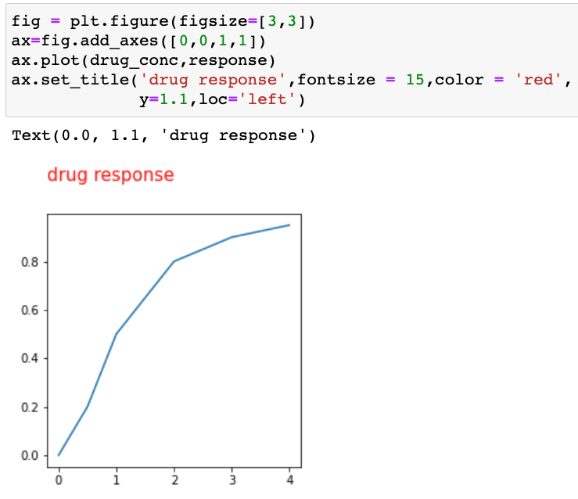
Formatting Axes
ax.set_title (label, fontdict=None, loc=None, pad=None, y=None)
Set a title for the axes.

Slide 25
Formatting Axes
ax.set_xlabel(xlabel, fontdict=None, labelpad=None, loc=None)
ax.set_ylabel(ylabel, fontdict=None, labelpad=None, loc=None)
Set the label for the x- and y- axis.
xlabel/ylabel : str; The label text.
fontdict : dict; A dictionary controlling the appearance of the title text, including 'fontsize’ 'fontweight’, 'color’, etc.
loc : {'center', 'left', 'right’} / {'bottom', 'center', 'top'}
labelpad : float, default: None; Spacing in points from the axes bounding box including ticks and tick labels.

Slide 26
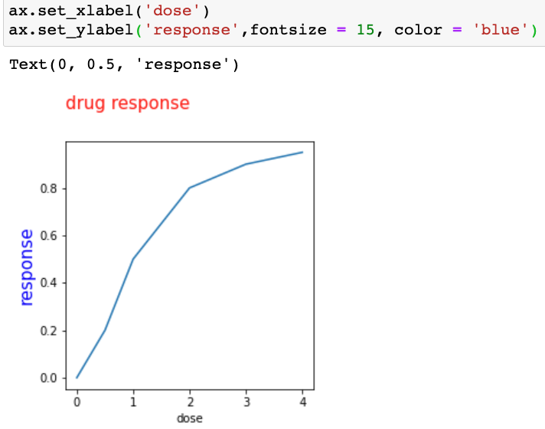
Formatting Axes
ax.set_xlabel(xlabel, fontdict=None, labelpad=None, loc=None)
ax.set_ylabel(ylabel, fontdict=None, labelpad=None, loc=None)

Slide 27
Parts of a Figure
class Figure
The whole figure. The figure keeps track of all the child class Axes
class Axes
This is what you think of as 'a plot', it is the region of the image with the data space.

Slide 28
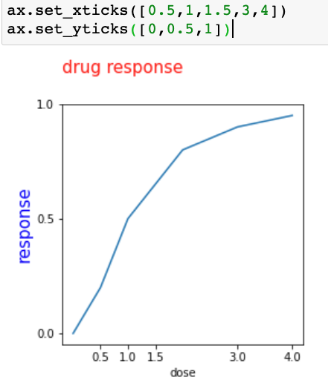
Formatting Axes
ax.set_xticks(ticks)
ax.set_yticks(ticks)
Set the x- / y- axis' tick locations. ticks : list of floats List of tick locations.

Slide 29
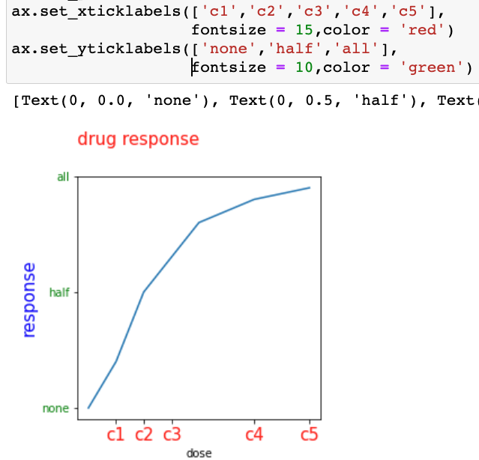
Formatting Axes
ax.set_xticklabels(labels, fontdict=None)
ax.set_yticklabels(labels, fontdict=None)
Set the x- / y- axis' labels with list of string labels.
labels : list of str The label texts.
fontdict : dict, optional A dictionary controlling the appearance of the ticklabels.

Slide 30
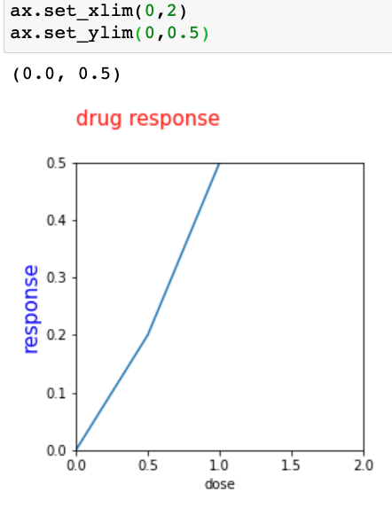
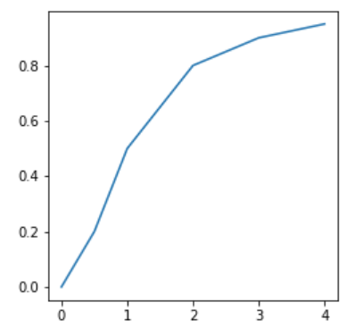
Formatting Axes
ax.set_xlim( left=None, right=None)
ax.set_ylim( left=None, right=None)
Set the x- / y- axis view limits.
left, right : float, optional; The left / right limit in data coordinates.

Slide 31
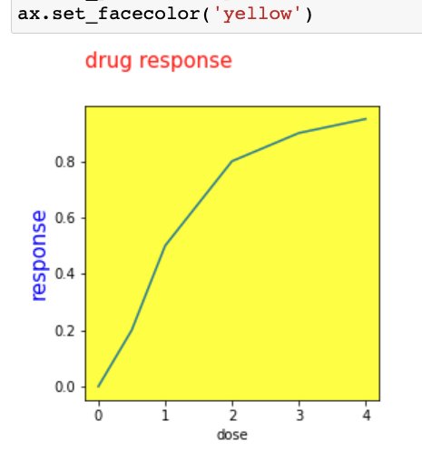
Formatting Axes
ax.set_facecolor(color)
Set the facecolor of the Axes.

Slide 32
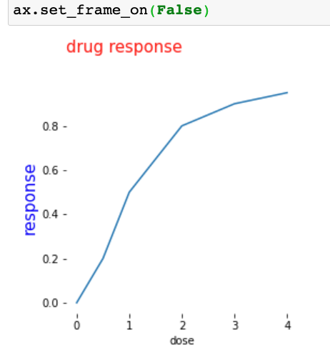
Formatting Axes
ax.set_frame_on(b)
Set whether the axes rectangle patch is drawn.

Slide 33
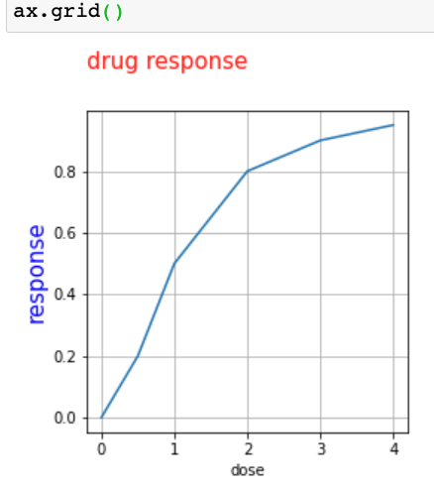
Formatting Axes
ax.grid(b=None, axis='both’)
Configure the grid lines.
b : bool or None, optional Whether to show the grid lines.
axis : {'both', 'x', 'y'}, optional The axis to apply the changes on.

Slide 34
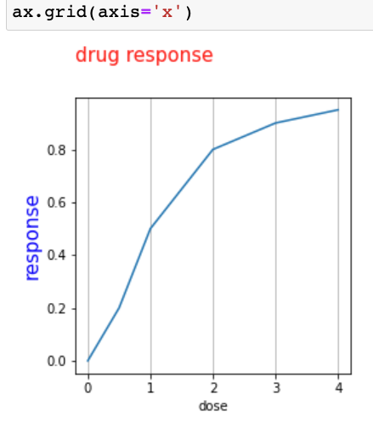
Formatting Axes
ax.grid(b=None, axis='both’)
Configure the grid lines.
b : bool or None, optional Whether to show the grid lines.
axis : {'both', 'x', 'y'}, optional The axis to apply the changes on.

Slide 35
Parts of a Figure
class Figure
The whole figure. The figure keeps track of all the child class Axes
class Axes
This is what you think of as 'a plot', it is the region of the image with the data space.

Slide 36
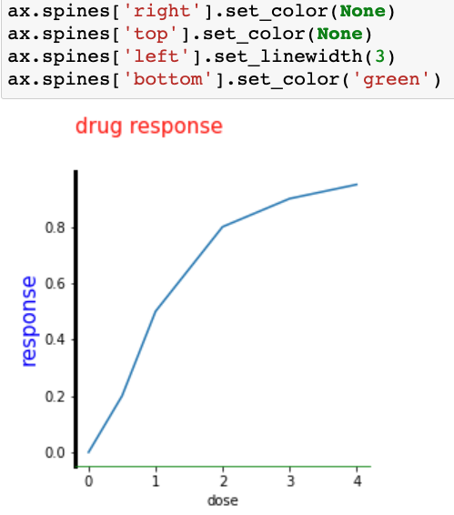
Formatting Axes
Spines: spines are the lines connecting axis tick marks demarcating boundaries of plot area.
The axes object has 4 spines located at top, bottom, left and right.
Each spine can be formatted by specifying color and width. Any edge can be made invisible if its color is set to none.
spine.set_color()
spine.set_linewidth()

Slide 37
Parts of a Figure
class Figure
The whole figure. The figure keeps track of all the child class Axes
class Axes
This is what you think of as 'a plot', it is the region of the image with the data space.

Slide 38
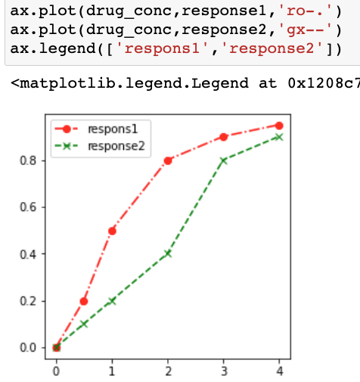
Formatting Axes
ax.legend(labels, loc, fontsize, title, frameon…)
Place a legend on the axes.
labels : list of str, optional A list of labels to show
loc : str or pair of floats; The location of the legend.
Right | 5
center left | 6
Center right | 7
lower center | 8
upper center | 9
Center | 10
Location string | Location code
Best | 0
upper right | 1
upper left | 2
lower left | 3
lower right | 4

Slide 39
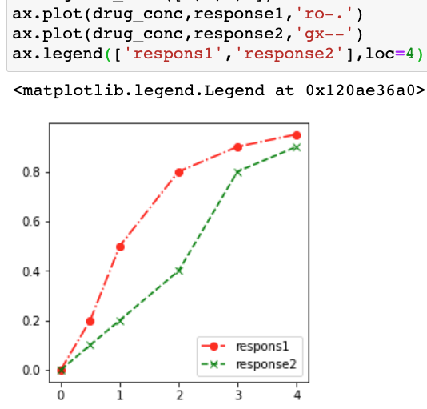
Formatting Axes
ax.legend(labels, loc, fontsize, title, frameon…)
Place a legend on the axes.
labels : list of str, optional A list of labels to show
loc : str or pair of floats; The location of the legend.
Right | 5
center left | 6
Center right | 7
lower center | 8
upper center | 9
Center | 10
Location string | Location code
Best | 0
upper right | 1
upper left | 2
lower left | 3
lower right | 4

Slide 40
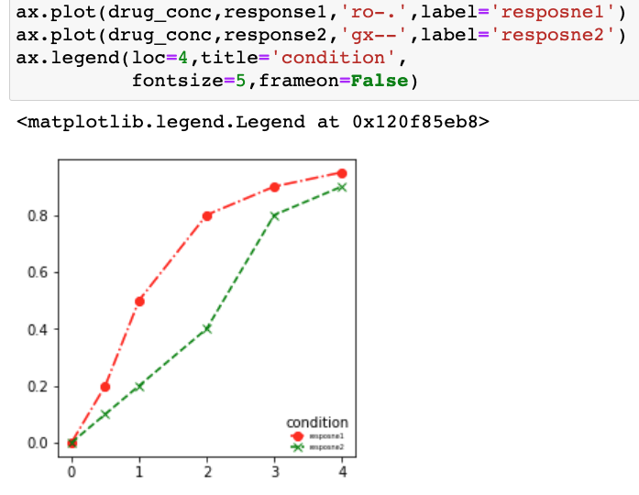
Formatting Axes
ax.legend(labels, loc, fontsize, title, frameon…)
Place a legend on the axes.
labels : list of str, optional A list of labels to show
loc : str or pair of floats; The location of the legend.
Right | 5
center left | 6
Center right | 7
lower center | 8
upper center | 9
Center | 10
Location string | Location code
Best | 0
upper right | 1
upper left | 2
lower left | 3
lower right | 4

Slide 41
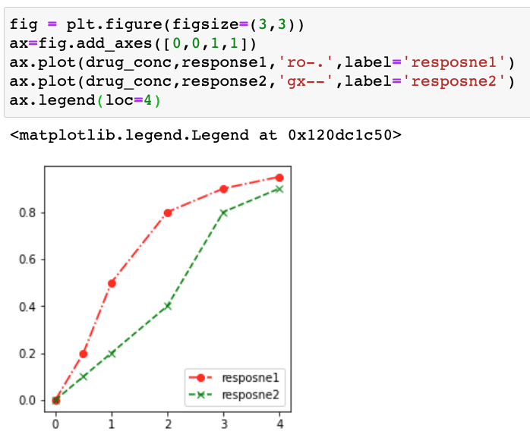
Formatting Axes
ax.legend(labels, loc, fontsize, title, frameon…)
Place a legend on the axes.
labels : list of str, optional A list of labels to show
loc : str or pair of floats; The location of the legend.
Right | 5
center left | 6
Center right | 7
lower center | 8
upper center | 9
Center | 10
Location string | Location code
Best | 0
upper right | 1
upper left | 2
lower left | 3
lower right | 4

Slide 42
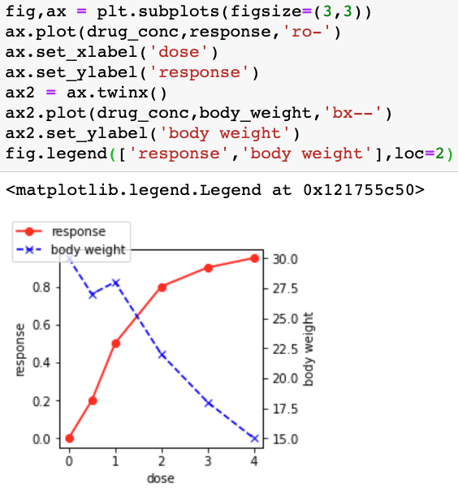
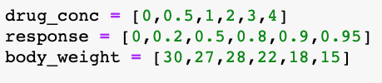
Twin Axes
ax.twinx()
ax.twiny()
Create a new Axes with an invisible x-/ y- axis and an independent y- / x- axis positioned opposite to the original one.

Slide 43
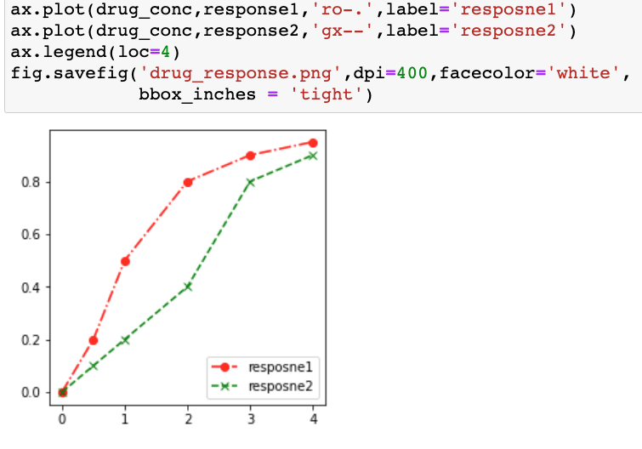
Saving Figures
Figure.savefig((fname, dpi=None)
Save the current figure.
fname : str or path-like or file-like；File path
dpi : float；The resolution in dots per inch.
facecolor : color or 'auto', The facecolor of the figure.
edgecolor : color or 'auto’,
The edgecolor of the figure.
bbox_inches :
Bounding box in inches: only the given portion of the figure is saved. If 'tight', try to figure out the tight bbox of the figure.

Slide 44
Axes: Types of Plots
Function | Description
Bar | Make a bar plot.
Barh | Make a horizontal bar plot.
Boxplot | Make a box and whisker plot.
Hist | Plot a histogram.
hist2d | Make a 2D histogram plot.
Pie | Plot a pie chart.
Plot | Plot lines and/or markers to the Axes.
Polar | Make a polar plot.
Scatter | Make a scatter plot of x vs y.
Stackplot | Draws a stacked area plot.
Stem | Create a stem plot.
Step | Make a step plot.
Quiver | Plot a 2-D field of arrows.

Slide 45
Axes: Types of Plots
https://matplotlib.org/stable/gallery/index.html

Slide 46
Axes.plot()
Plot y versus x as lines and/or markers.

Slide 47
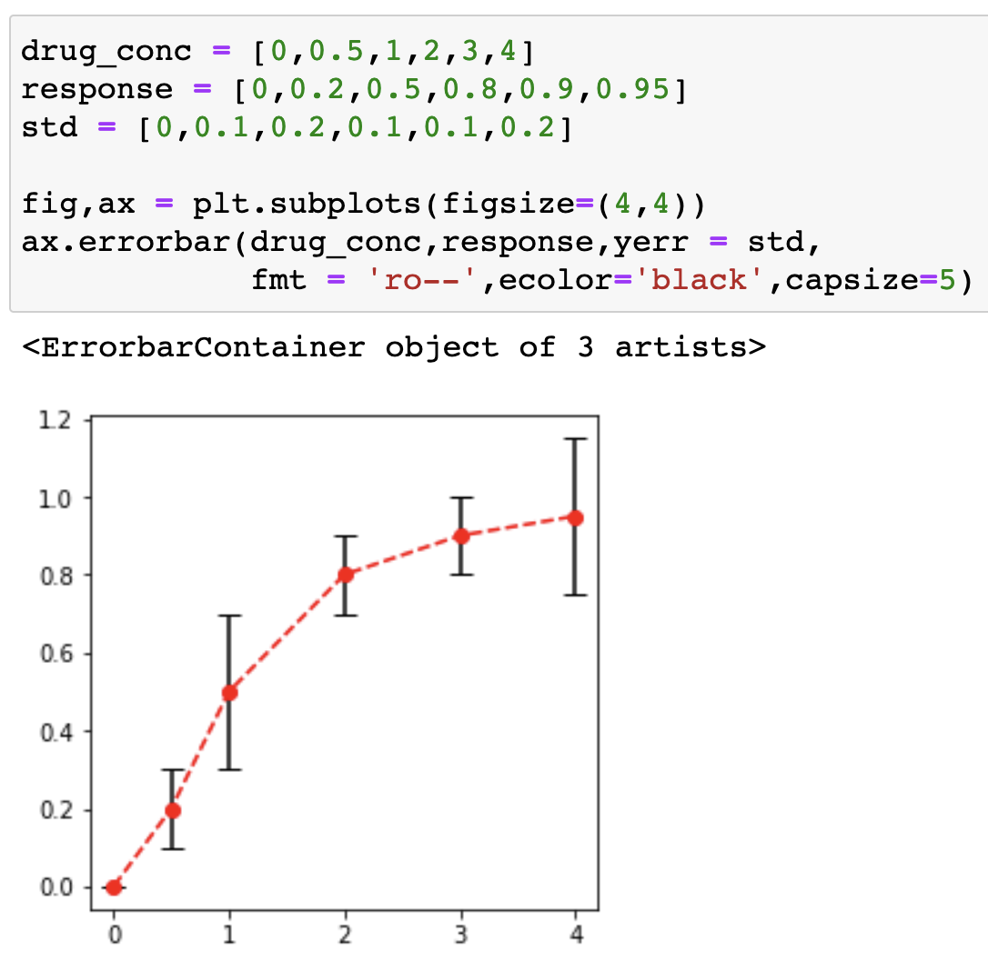
Axes.errorbar()
Plot y versus x as lines and/or markers with attached errorbars.
ax.errorbar( x, y, yerr=None, xerr=None, fmt='', ecolor=None, elinewidth=None, capsize=None,…)
x, y : array-like; The data positions.
xerr, yerr : float or array-like; The errorbar sizes
fmt : str.; The format for the data points / data lines
ecolor : color; The color of the errorbar lines.
elinewidth : float; The linewidth of the errorbar lines.
capsize : float; The length of the error bar caps in points.

Slide 48
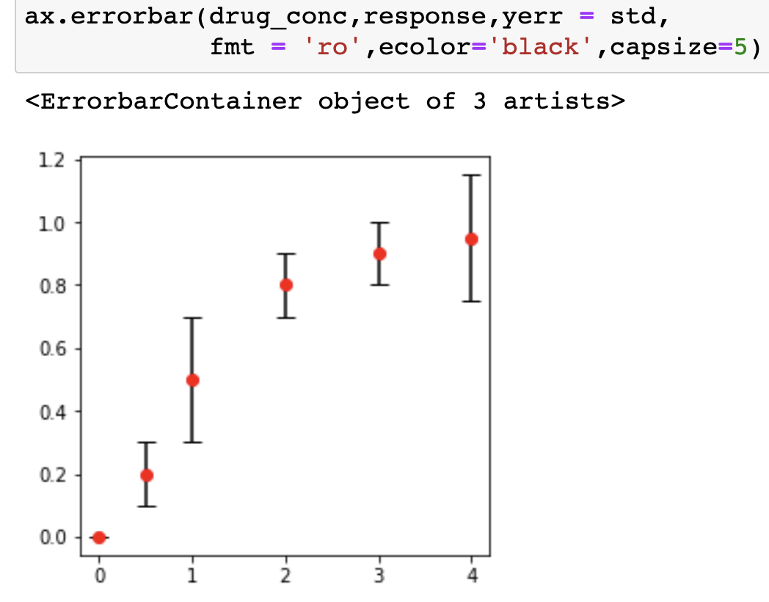
Axes.errorbar()
Plot y versus x as lines and/or markers with attached errorbars.
ax.errorbar( x, y, yerr=None, xerr=None, fmt='', ecolor=None, elinewidth=None, capsize=None,…)
x, y : array-like; The data positions.
xerr, yerr : float or array-like; The errorbar sizes
fmt : str.; The format for the data points / data lines
ecolor : color; The color of the errorbar lines.
elinewidth : float; The linewidth of the errorbar lines.
capsize : float; The length of the error bar caps in points.

Slide 49
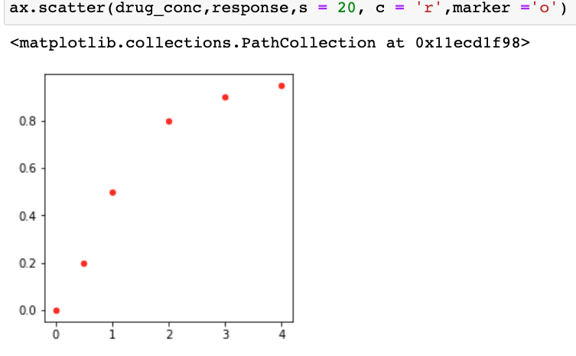
Axes.scatter()
A scatter plot of y vs. x
ax.scatter( x, y, s=None, c=None, marker=None)
x, y : array-like; The data positions.
s : float or array-like, shape (n, ), optional;
The marker size.
c : array-like or list of colors or color, optional;
The marker colors.
marker: The marker style.

Slide 50
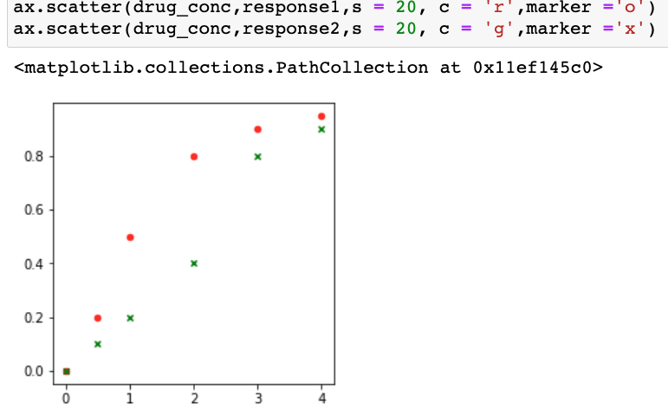
Axes.scatter()
A scatter plot of y vs. x
ax.scatter( x, y, s=None, c=None, marker=None)
x, y : array-like; The data positions.
s : float or array-like, shape (n, ), optional;
The marker size.
c : array-like or list of colors or color, optional;
The marker colors.
marker: The marker style.
Multiple scatter plots in one axes.

Slide 51
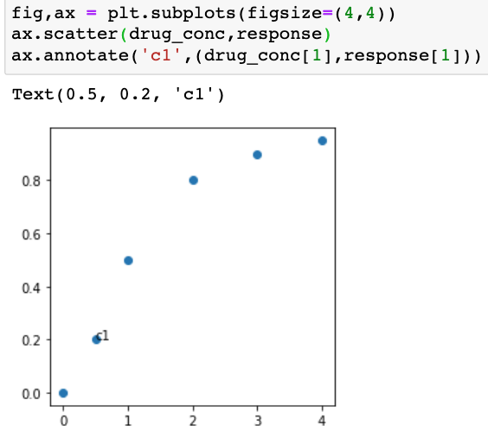
Axes.annotate()
Annotate the point with text
ax.annotate(text, xy, xytext, textcoords …)
text : str The text of the annotation.
xy : (float, float) The point *(x, y)* to annotate.
xytext : (float, float); Offset to place the text.
textcoords: 'offset points’ or 'offset pixels’

Slide 52
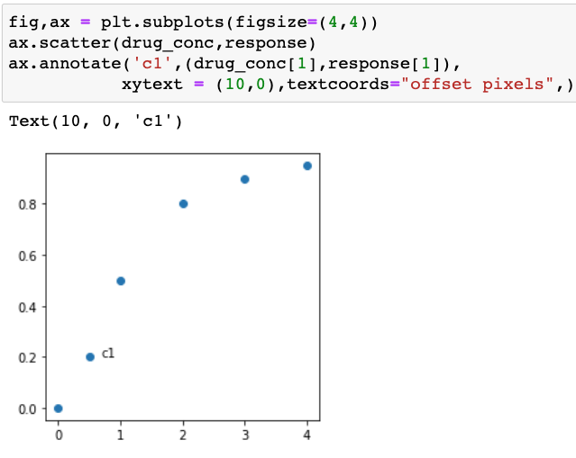
Axes.annotate()
Annotate the point with text
ax.annotate(text, xy, xytext, textcoords …)
text : str The text of the annotation.
xy : (float, float) The point *(x, y)* to annotate.
xytext : (float, float); Offset to place the text.
textcoords: 'offset points’ or 'offset pixels’
change annotation position

Slide 53
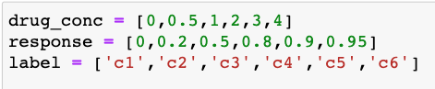
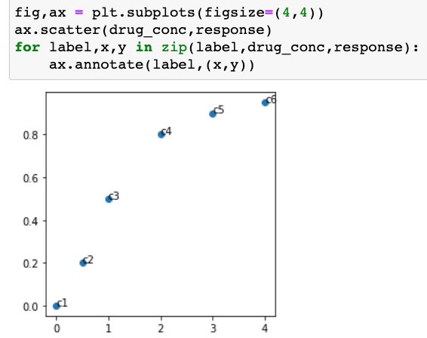
Axes.annotate()
Annotate the point with text
ax.annotate(text, xy, xytext, textcoords …)
text : str The text of the annotation.
xy : (float, float) The point *(x, y)* to annotate.
xytext : (float, float); Offset to place the text.
textcoords: 'offset points’ or 'offset pixels’
add annotations in a FOR loop

Slide 54
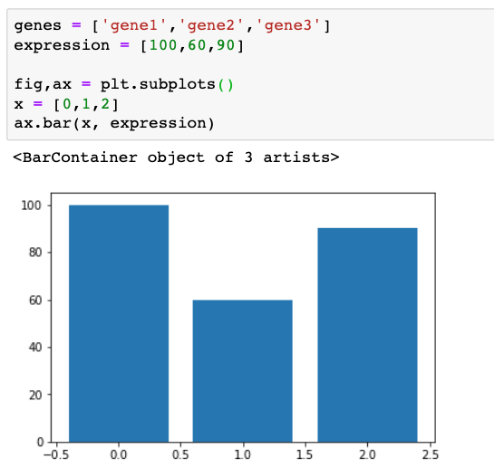
Axes.bar()
Make a bar plot.
axes.bar (x, height, width, bottom, align)
The function makes a bar plot with the bound rectangle of size (x −width/2; x + width/2; bottom; bottom + height).
x : float or array-like; The x coordinates of the bars.
height : float or array-like; The height(s) of the bars.
width : float or array-like, default: 0.8; The width(s) of the bars.
bottom : float or array-like, default: 0; The y coordinate(s) of the bars bases.
align : {'center', 'edge'}, default: 'center’

Slide 55
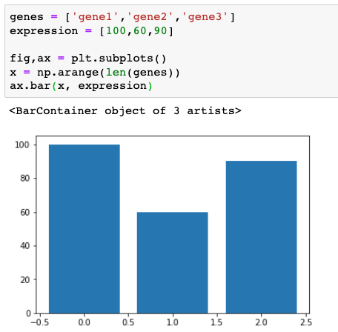
Axes.bar()
Make a bar plot.
axes.bar (x, height, width, bottom, align)
The function makes a bar plot with the bound rectangle of size (x −width/2; x + width/2; bottom; bottom + height).
x : float or array-like; The x coordinates of the bars.
height : float or array-like; The height(s) of the bars.
width : float or array-like, default: 0.8; The width(s) of the bars.
bottom : float or array-like, default: 0; The y coordinate(s) of the bars bases.
align : {'center', 'edge'}, default: 'center’

Slide 56
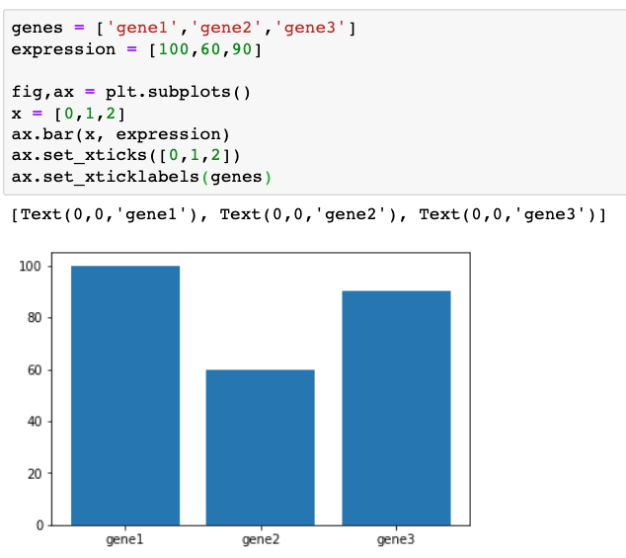
Axes.bar()
Make a bar plot.
axes.bar (x, height, width, bottom, align)
The function makes a bar plot with the bound rectangle of size (x −width/2; x + width/2; bottom; bottom + height).
Set xtick labels

Slide 57
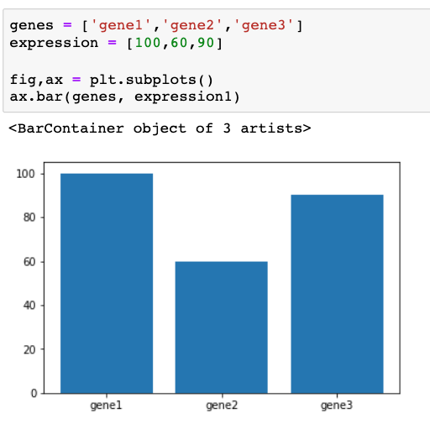
Axes.bar()
Make a bar plot.
axes.bar (x, height, width, bottom, align)
The function makes a bar plot with the bound rectangle of size (x −width/2; x + width/2; bottom; bottom + height).

Slide 58
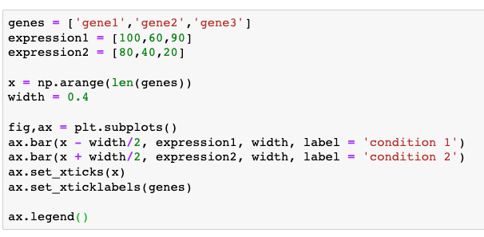

Axes.bar()
Make a bar plot.
axes.bar (x, height, width, bottom, align)
Multiple bar charts side by side

Slide 59

Axes.bar()
Make a bar plot.
axes.bar (x, height, width, bottom, align)
Multiple bar charts

Slide 60

Axes.bar()
Make a bar plot.
axes.bar (x, height, width, bottom, align)
Stacked bar graph

Slide 61

Axes.bar()
Make a bar plot.
axes.bar (x, height, width, bottom, align,
xerr, yerror, ecolor, capsize)
Adding error bars:
xerr, yerr : float or array-like of shape(N,)
The values are +/- sizes relative to the data:
ecolor : color or list of color, default: 'black' The line color of the errorbars.
capsize : float;
The length of the error bar caps in points.

Slide 62


Axes.hist()
Make a histogram plot.
np.random. normal(loc=0.0, scale=1.0, size=None)
Draw random samples from a normal distribution.
loc: mean; scale: Standard deviation; size: number of values
axes.hist(x, bins)
A histogram is an accurate representation of the distribution of numerical data.
To construct a histogram:
Bin the range of values.
Divide the entire range of values into a series of intervals.
Count how many values fall into each interval.
bins : int or sequence or str; If *bins* is an integer, it defines the number of equal-width bins in the range

Slide 63


Axes.hist()
Make a histogram plot.
np.random. normal(loc=0.0, scale=1.0, size=None)
Draw random samples from a normal distribution.
loc: mean; scale: Standard deviation; size: number of values
axes.hist(x, bins)
A histogram is an accurate representation of the distribution of numerical data.
Change number of bins

Slide 64


Axes.pie()
Plot a pie chart.
ax.pie( x, explode=None, labels=None,,..)
x : 1D array-like; The wedge sizes.
labels : list; A sequence of strings providing the labels for each wedge.
autopct : a string or function used to label the wedges with their numeric value. The label will be placed inside the wedge.

Slide 65

Axes.boxplot()
Make a box plot.
A box plot which is also known as a whisker plot displays a summary of a set of data containing the minimum, first quartile, median, third quartile, and maximum. In a box plot, we draw a box from the first quartile to the third quartile. A vertical line goes through the box at the median. The whiskers go from each quartile to the minimum or maximum.

Slide 66


Axes.boxplot()
Make a box plot.
ax.boxplot(x, …,)
x : Array or a sequence of vectors. The input data.

Slide 67

Axes.violinplot()
Make a violin plot.
Violin plots are similar to box plots, except that they also show the probability density of the data at different values. A violin plot is more informative than a plain box plot.
In fact while a box plot only shows summary statistics such as mean/median and interquartile ranges, the violin plot shows the full distribution of the data.

Slide 68


Axes.violinplot()
Make a violin plot.
ax.violinplot(x, …,)
x : Array or a sequence of vectors. The input data.

Slide 69
Axes.stackplot()
Make a stack plot.
ax.stackplot(x, …,)
Stackplots draw multiple datasets as vertically stacked areas. This is useful when the individual data values and additionally their cumulative value are of interest.
x : Array or a sequence of vectors. The input data.

Slide 70



Axes.stackplot()
ax.stackplot(x, …,)

Slide 71
Multiple plots in one figure
plt.subplots( nrows=1, ncols=1)
Create a figure and a set of subplots axes;
Return a Figure and Axes

Slide 72
Multiple plots in one figure
plt.subplots( nrows=1, ncols=1)
Create a figure and a set of subplots axes;
Return a Figure and Axes

Slide 73


Multiple plots in one figure

Slide 74


Multiple plots in one figure
fig.tight_layout(*, pad=1.08, h_pad=None, w_pad=None, rect=None)
Adjust the padding between and around subplots.

Slide 75


Multiple plots in one figure
Similar to tight_layout, constrained_layout automatically adjusts subplots and decorations like legends and colorbars so that they fit in the figure window while still preserving, as best they can, the logical layout requested by the user.

Slide 76
Multiple plots in one figure
Figure.add_subplot(*args, **kwargs)
Add an Axes to the figure as part of a subplot arrangement;
*args: int, (int, int, index), or SubplotSpec, default: (1, 1, 1)The position of the subplot described by one of three integers (nrows, ncols, index). The subplot will take the index position on a grid with nrows rows and ncols columns. index starts at 1 in the upper left corner and increases to the right. index can also be a two-tuple specifying the (first, last) indices (1-based, and including last) of the subplot, e.g., fig.add_subplot(3, 1, (1, 2)) makes a subplot that spans the upper 2/3 of the figure.
A 3-digit integer. The digits are interpreted as if given separately as three single-digit integers, i.e. fig.add_subplot(235) is the same as fig.add_subplot(2, 3, 5). Note that this can only be used if there are no more than 9 subplots.

Slide 77

Multiple plots in one figure
Figure.add_subplot(*args, **kwargs)
More parameters
https://matplotlib.org/stable/api/figure_api.html#matplotlib.figure.Figure.add_subplot

Slide 78


Multiple plots in one figure

Slide 79
Multiple plots in one figure
GridSpec: specifies the geometry of the grid that a subplot will be placed.
Multiple subplots using the GridSpec function. You can create the figure and GridSpec instance separately, then pass elements of gridspec instance to the add_subplot() method to create the axes objects. The elements of the gridspec are accessed in generally the same manner as numpy arrays.
The power of gridspec comes in being able to create subplots that span rows and columns, using the NumPy slice syntax for selecting the part of the gridspec each subplot will occupy.

Slide 80


Multiple plots in one figure

Slide 81


Multiple plots in one figure
We can also use the convenience method Figure.add_gridspec() instead of gridspec.GridSpec.

Slide 82


Multiple plots in one figure
When a GridSpec is explicitly used, you can adjust the layout parameters of subplots that are created from the GridSpec.
left, right, top, bottom float, optional Extent of the subplots as a fraction of figure width or height. Left cannot be larger than right, and bottom cannot be larger than top. If not given, the values will be inferred from a figure or rcParams at draw time.
wspace, hspace float, optional The amount of width/ height reserved for space between subplots, expressed as a fraction of the average axis width. If not given, the values will be inferred from a figure or rcParams when necessary.

Slide 83


Multiple plots in one figure
When a GridSpec is explicitly used, you can adjust the layout parameters of subplots that are created from the GridSpec.
left, right, top, bottom float, optional Extent of the subplots as a fraction of figure width or height. Left cannot be larger than right, and bottom cannot be larger than top. If not given, the values will be inferred from a figure or rcParams at draw time.
wspace, hspace float, optional The amount of width/ height reserved for space between subplots, expressed as a fraction of the average axis width. If not given, the values will be inferred from a figure or rcParams when necessary.

Slide 84

Multiple plots in one figure

Slide 85

Multiple plots in one figure

